Slide 1
Properties and Encapsulation

Slide 2
Encapsulation
The meaning of Encapsulation, is to make sure that "sensitive" data is hidden from users. To achieve this, you must:
declare fields/variables as private
provide public get and set methods, through properties, to access and update the value of a private field

Slide 3
Definition
Encapsulation is defined as the wrapping up of data under a single unit. It is the mechanism that binds together code and the data it manipulates. In a different way, encapsulation is a protective shield that prevents the data from being accessed by the code outside this shield.
Technically in encapsulation, the variables or data of a class are hidden from any other class and can be accessed only through any member function of own class in which they are declared.
As in encapsulation, the data in a class is hidden from other classes, so it is also known as data-hiding.
Encapsulation can be achieved by: Declaring all the variables in the class as private and using C# Properties in the class to set and get the values of variables.

Slide 4
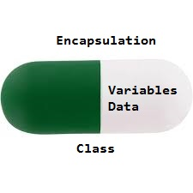
Encapsulation by figure

Slide 5
Advantages of Encapsulation:
Data Hiding: The user will have no idea about the inner implementation of the class. It will not be visible to the user that how the class is stored values in the variables. He only knows that we are passing the values to accessors and variables are getting initialized to that value.
Increased Flexibility: We can make the variables of the class as read-only or write-only depending on our requirement. If we wish to make the variables as read-only then we have to only use Get Accessor in the code. If we wish to make the variables as write-only then we have to only use Set Accessor.
Reusability: Encapsulation also improves the re-usability and easy to change with new requirements.
Testing code is easy: Encapsulated code is easy to test for unit testing.

Slide 6
Automatic Properties (Short Hand)
C# also provides a way to use short-hand or automatic properties
where you do not have to define the field for the property, and you only have to write get; and set; inside the property
class Person { public string Name // property { get; set; } }

